Slide 1

FED
WE
E
K
Introduction to AJAX and jQuery
Front End Development
Diploma in CSF
Year 1 (2021/22), Semester 2
8

Slide 2
Remote Learning Instructions
Step 1
Read the given slides
Details in slide 1-7
Step 2
Perform highlighted activities in Activities slide
Details in slide 6
Step 3
Complete and Submit Tasks given
Details in slide 7

Slide 3
Learning Objectives
At the end of this week’s practical exercises you will learn to:
Update a web page without reloading the page
Request data from a server
Receive data from a server
Read XML data into a web page using jQuery
Create a slideshow using jQuery

Slide 4
What is AJAX?
AJAX stand for Asynchronous JavaScript And XML.
While not a technology in itself, it is a term that describes a "new" approach to using a number of existing technologies together, including:
HTML or XHTML, Cascading Style Sheets, JavaScript, The Document Object Model, XML, XSLT, and most importantly the XMLHttpRequest object.
It is able to:
Update a web page without reloading the page
Request data from a server - after the page has loaded
Receive data from a server - after the page has loaded
Send data to a server - in the background

Slide 5
What is jQuery?
jQuery is a fast, small, and feature-rich JavaScript library.
It makes things like HTML document traversal and manipulation, event handling, animation, and Ajax much simpler with an easy-to-use API that works across a multitude of browsers.
With a combination of versatility and extensibility, jQuery has changed the way that millions of people write JavaScript.

Slide 6
Activities
Read the following from the textbook.
What is Ajax (p.633)
jQuery and Other Libraries (pp.633 – 637)
Read “AJAX Introduction” from w3schools.com and follow the examples
https://www.w3schools.com/xml/ajax_intro.asp
Read the posts on “AJAX for Front-End Designers” from tuts+ and follow the examples.
https://webdesign.tutsplus.com/series/ajax-for-front-end-designers--cms-967

Slide 7
Tasks
Complete Week 8 Practical.
Download Week 8 Practical in MEL – “FED 2021-10 Week 8 Worksheet.pdf”
Deadline end of Week 8
Submit the completed practical files in MEL.
Zipped the source files
Name the zipped file in following format:-
FED-Week08-SXXXXXXXX (where SXXXXXXXX is your student id)
Submit the zipped file in the weekly folder’s submission link in MEL
Also, submit the zipped file into FED network folder (https:///ictspace.ict.np.edu.sg/FED) under your studentID. This is for backup purpose only. Main submission is still in MEL.
If you have any questions please communicate with your tutor via Microsoft Teams.

Slide 8
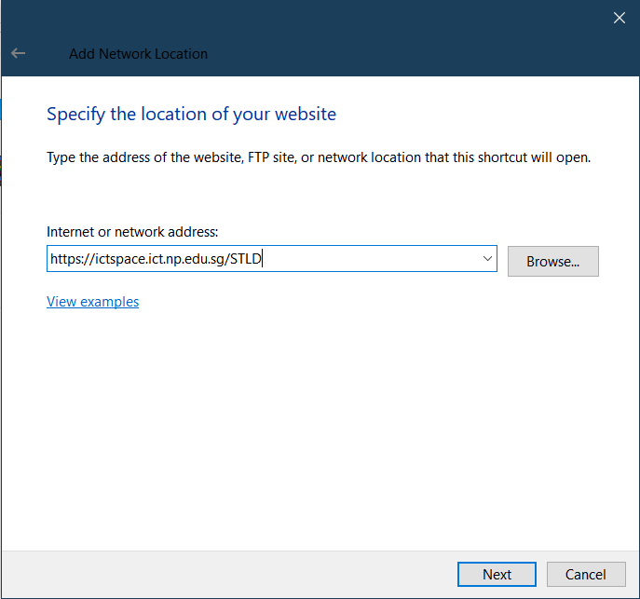
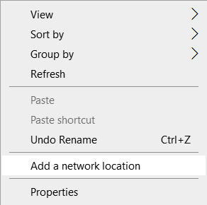
Appendix
Mapped to FED network folder
For Win Users
Right click on a blank space in your Windows Explorer
Select ‘Add a network location’
3. Enter https://ictspace.ict.np.edu.sg/(your assigned module)
4. Press ‘Next’

Slide 9
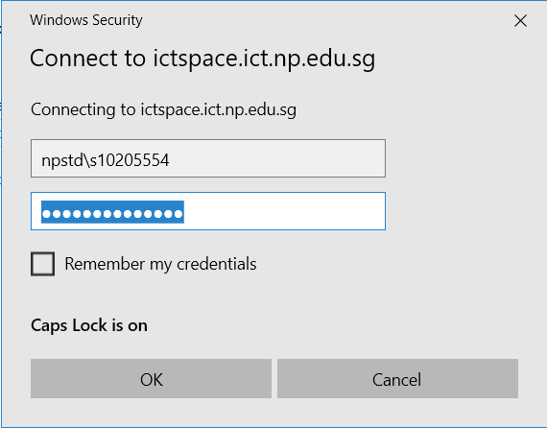
Appendix (Cont)
10123453
4. Login using npstd\s(your student ID number without the last alphabet)
5. Enter your NP student account password

Slide 10
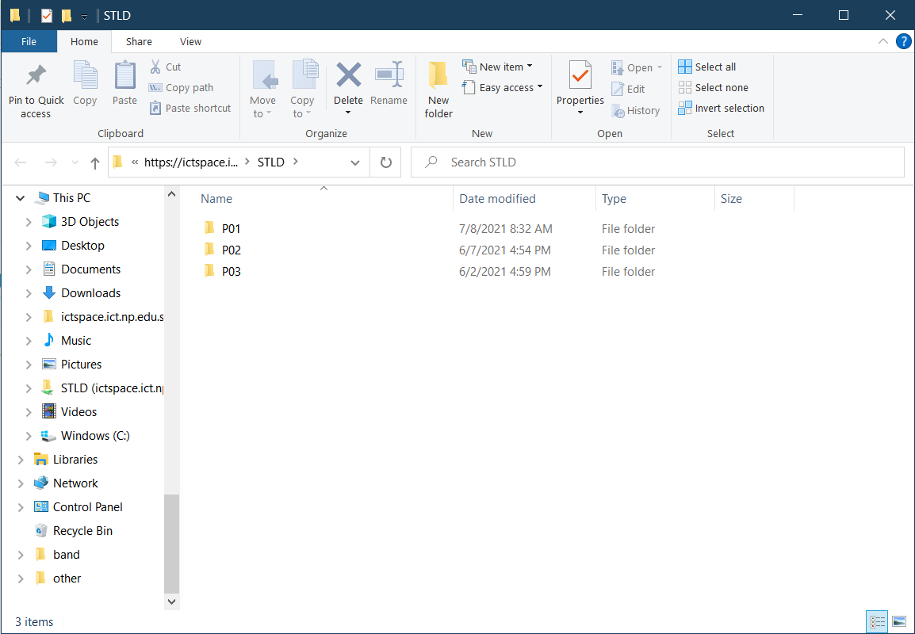
Appendix (Cont)
You should be able to see your class folder as shown in the example below.

